Slide 1
The census of public opinion

Slide 2
The problem

Slide 3
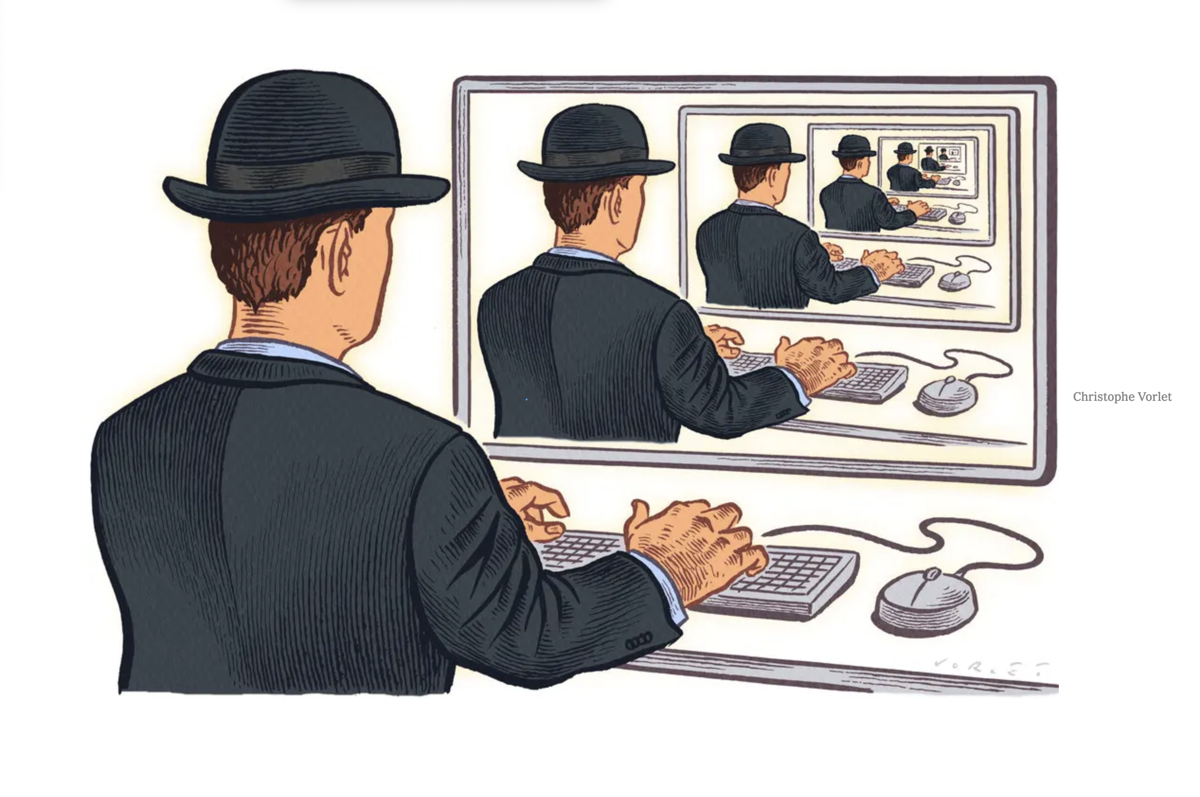
Echo chambers

Slide 4
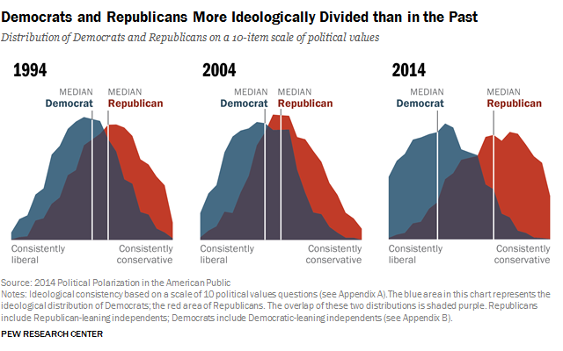
Polarisation
Notes:
The Problem Notes:
Recommender systems create personalized content which show the user opinions similar to their own
They generate huge incomes for companies: Netlfix Prize with the goal to create a system better than their own with a £1m reward
While they are useful for products like Netflix when recommending series and movies, when it comes to information, news and opinion, the affects are far more damaging
When only shown opinions that match your own, the ability to communication breaks down, increased polarisation
“pick your own news”
“we become so secure in our bubbles” that wrong and right is divided between our internal beliefs and theirs

Slide 5

The solution

Slide 6
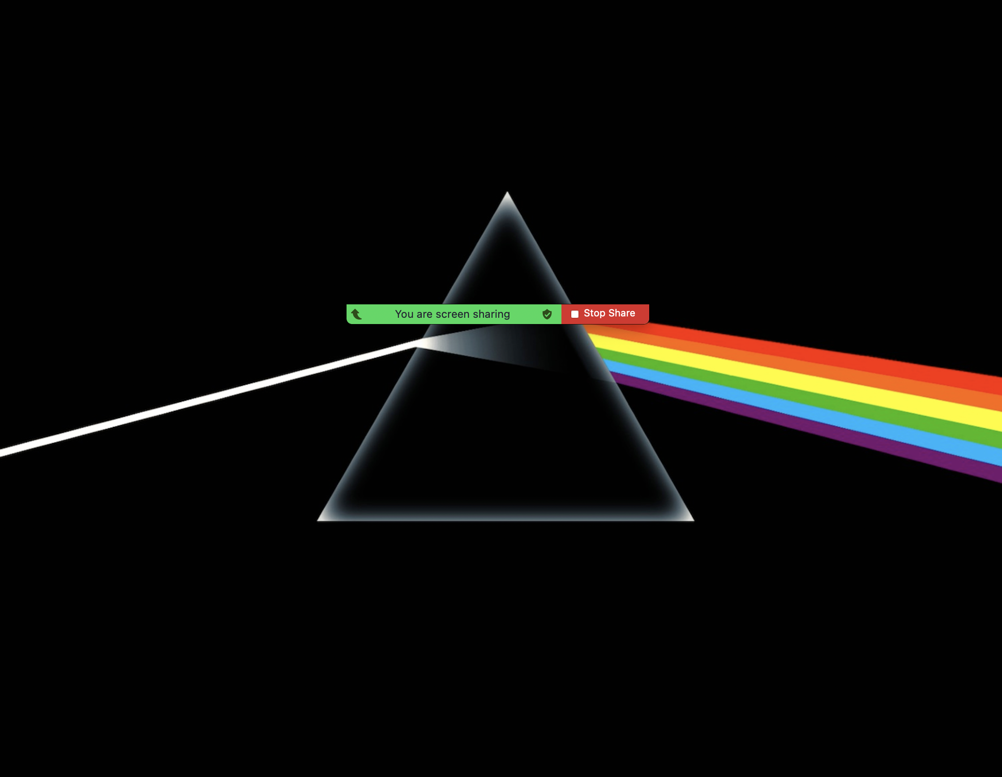
Prism Search
Notes:
The idea of prism search:
As the analogy suggests, a prism search is the idea of being able to access for the full spectrum of public opinion, that stems from your own
With our product, you will be able to search an interest of yours and get back a range of public opinions presented in a semantical 3d space (positioned and clustered on meaning.
How you ask?

Slide 8
Ins and outs
Top2Vec and (Roberta?)
Challenges (future)
Top2Vec
Time of Roberta and Google
Best way to reduce dimensionality
Notes:
Top2Vec Explanation:
Top2Vec embeds words and documents, to create topic vectors that display topics by sentimental closeness.
This simply means that each word and each document acts as a point in a high dimensional space.
An algorithm called UMAP is used to reduce the number of dimensions, before it uses HDBSCAN, a clustering algorithm to find distinct clusters in the dimensional space, which can be defined as a topic.
These topics are presented as vectors, that is the centroid of the document clusters.
Roberta Explanation:
In part of our analysis, we also utilize another important model within NLP
Roberta is a sentiment analysis model trained on 58m tweets; it categorises tweets into positive, negative and neutral

